Slide 1

Google Play Apps Data Analysis
By – Mohd Sazid Khan Pathan
Tech. Used – MySQL

Slide 2

Introduction to Dataset
Overview
Dataset Overview
The dataset contains over 10,000 mobile apps, providing a rich source of data for analysis.
Apps are categorized into 33 distinct categories, allowing for a comprehensive understanding of diverse app types.
Key metrics in the dataset include Ratings, Reviews, Installs, Price, and Last Updated, which are crucial for evaluating app performance.
The primary goal of this analysis is to uncover user preferences, identify trends across categories, and assess app performance metrics.

Slide 3

Agenda
Data Analysis of Mobile Apps Dataset
Introduction to Dataset
Top-Rated Apps by Category
Highest Average Ratings by Category
Category-Wise Distribution of Apps
Rating Distribution Analysis
App Size and Performance Correlation
Conclusion

Slide 4
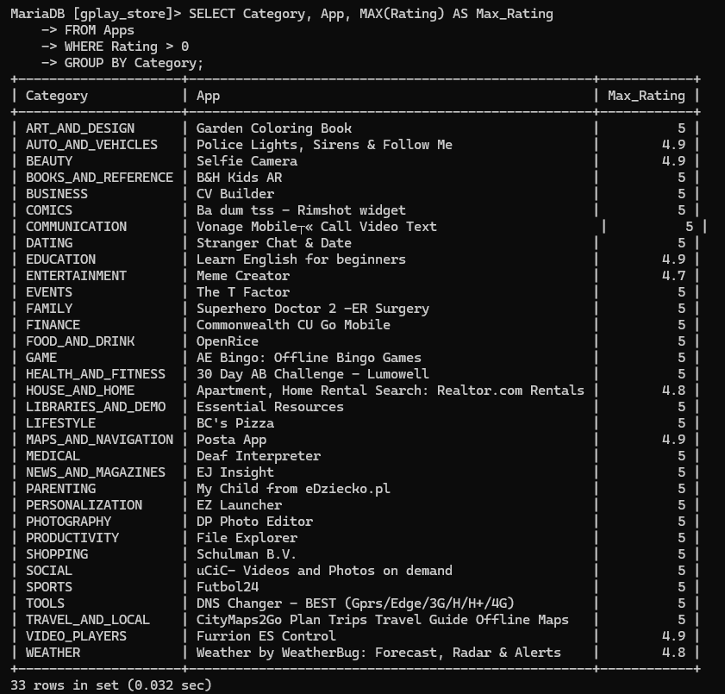
Top-Rated Apps by Category
What are the top-rated apps in each category?
SELECT Category, App, MAX(Rating) AS Max_Rating
FROM Apps
WHERE Rating > 0
GROUP BY Category;

Slide 5
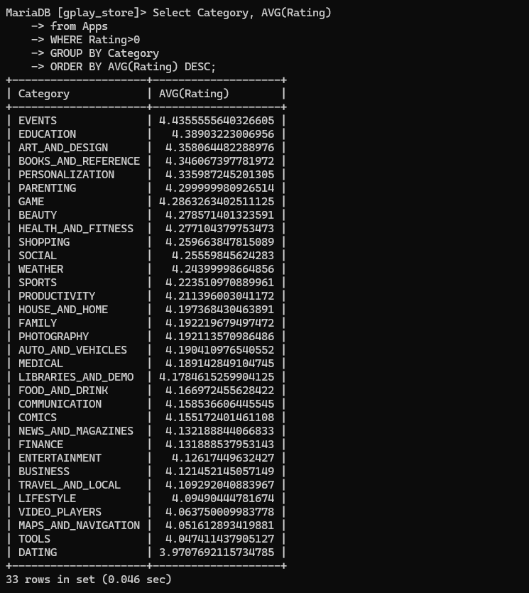
Highest Average Ratings by Category
Select Category, AVG(Rating)
from Apps
WHERE Rating>0
GROUP BY Category
ORDER BY AVG(Rating) DESC;

Slide 6
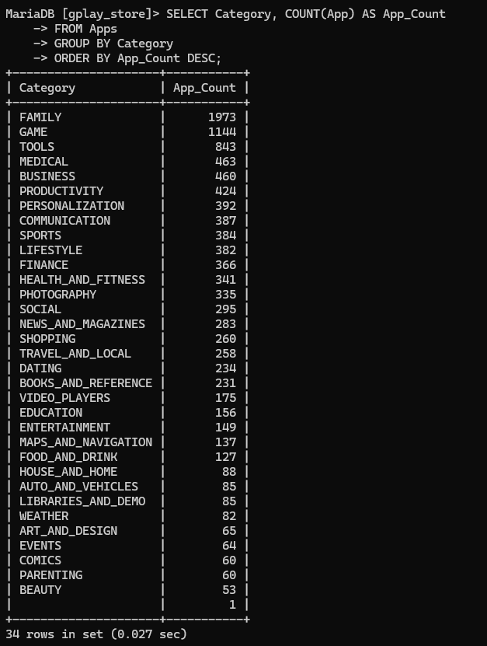
Category-Wise Distribution of Apps
How are apps distributed across different categories?
SELECT Category, COUNT(App) AS App_Count
FROM Apps
GROUP BY Category
ORDER BY App_Count DESC;

Slide 7
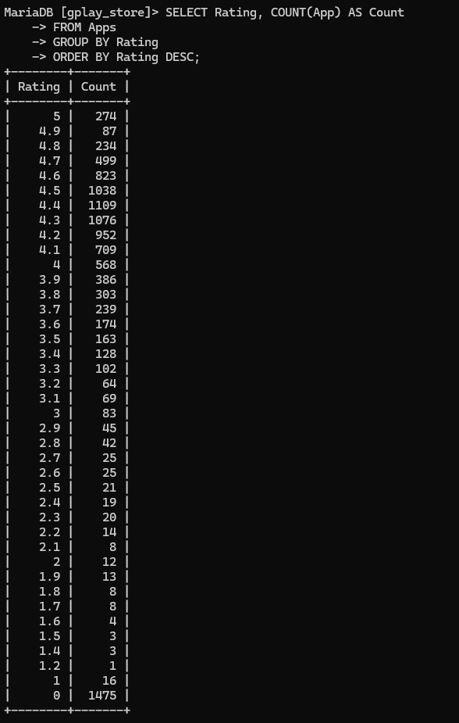
Rating Distribution Analysis
How are ratings distributed across apps?
SELECT Rating, COUNT(App) AS Count
FROM Apps
GROUP BY Rating
ORDER BY Rating DESC;

Slide 8
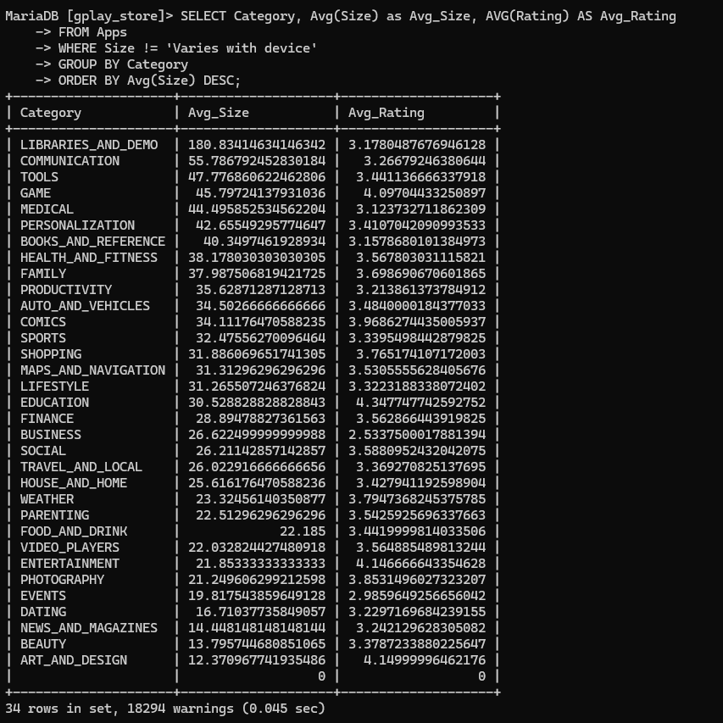
App Size and Performance Correlation
Is there a correlation between app size
and user ratings?
SELECT Category, Avg(Size) as Avg_Size, AVG(Rating) AS Avg_Rating
FROM Apps
WHERE Size != 'Varies with device'
GROUP BY Category
ORDER BY Avg(Size) DESC;

Slide 9
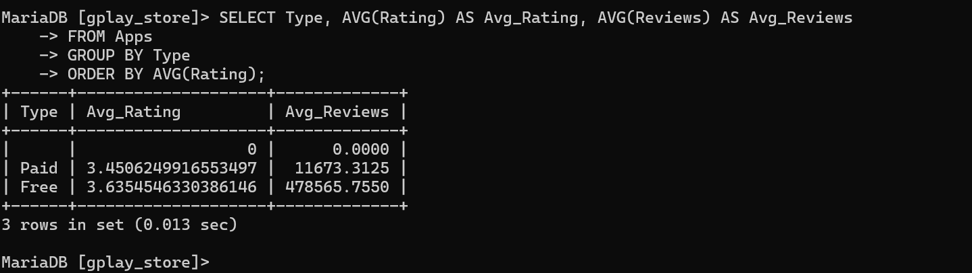
Paid vs. Free Apps
How do paid apps compare to free apps in
terms of ratings and reviews?
SELECT Type, AVG(Rating) AS Avg_Rating, AVG(Reviews) AS Avg_Reviews
FROM Apps
GROUP BY Type
ORDER BY AVG(Rating);

Slide 10
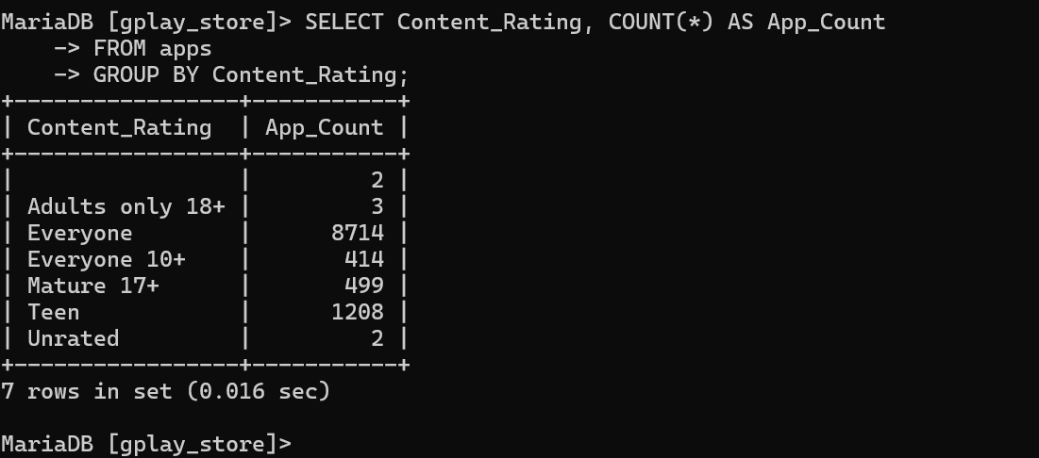
Apps by content rating
What is the distribution of apps by content rating (Everyone, Teen, etc.)?
SELECT Content_Rating, COUNT(*) AS App_Count
FROM apps
GROUP BY Content_Rating;

Slide 11
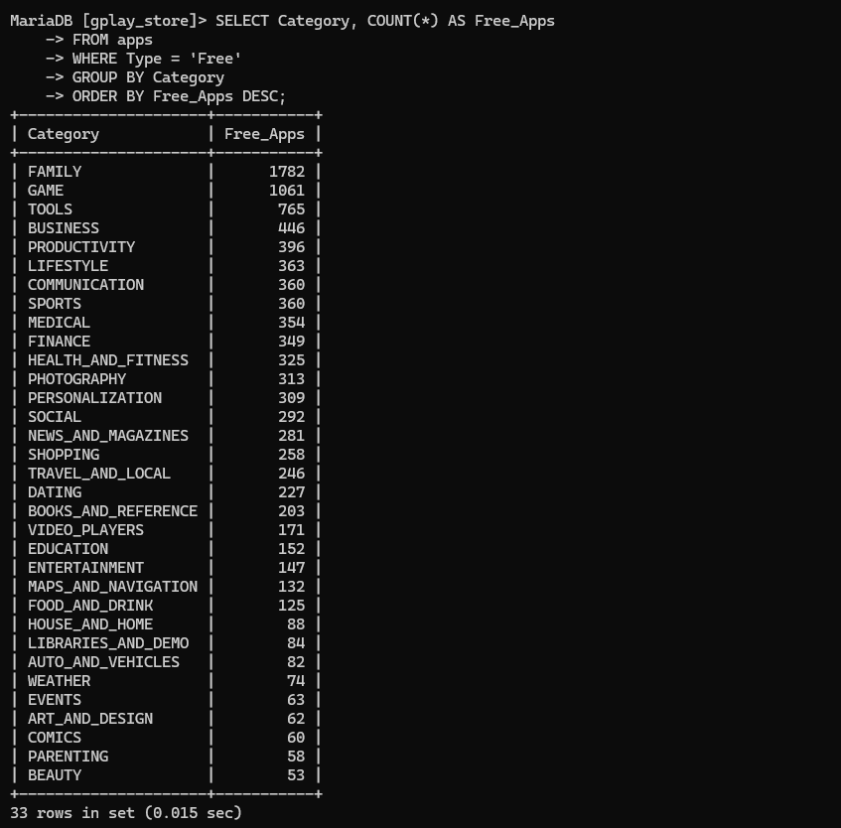
Category vs Free Apps
Which categories have the highest number of free apps?
SELECT Category, COUNT(*) AS Free_Apps FROM Apps
WHERE Type = ‘Free’
GROUP BY Category
ORDER BY Free_Apps DESC;

Slide 12
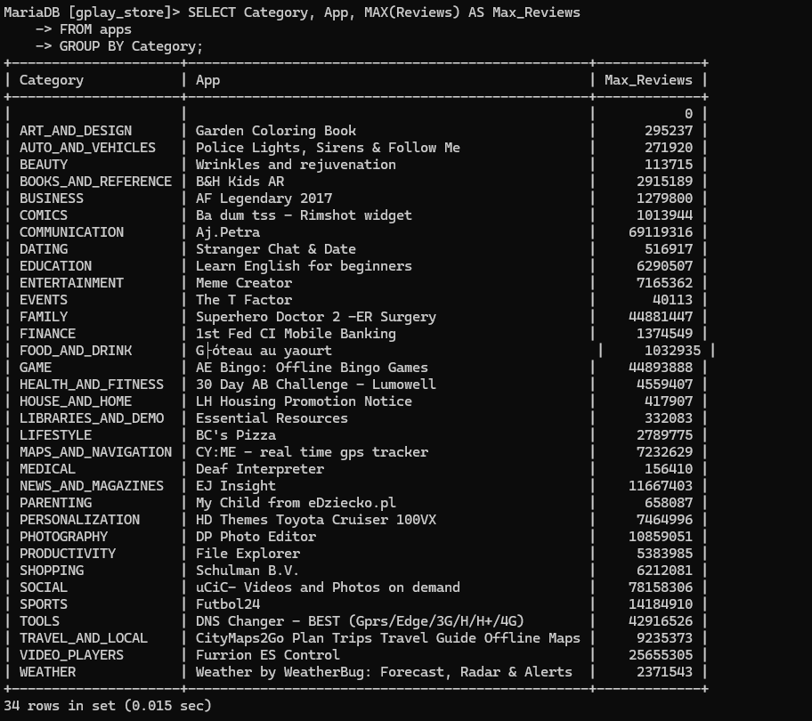
Category Reviews
Which apps have the highest number of reviews in each category?
SELECT Category, App, MAX(Reviews) AS Max_Reviews
FROM Apps
GROUP BY Category;

Slide 13
Conclusion
Summary
The analysis revealed that user ratings are predominantly influenced by the number of installs and recent updates.
Certain categories, such as Games and Productivity, consistently featured the highest average ratings, indicating user preference in these areas.
A notable trend showed that smaller apps often received higher ratings, suggesting a possible correlation between app size and user satisfaction.
Apps with regular updates tended to have better ratings, emphasizing the importance of ongoing developer support and engagement.
Overall, understanding these insights can guide developers in improving app features and addressing user needs effectively.

Slide 14
Thank you

